Slide 1
Secure data Hiding in Images using steganography
Presented By
Student Name: Suyash Bharte
College Name & Department: Gokhale Education Society’s R.H.Sapat College Of Engineering, Management Studies And Research – Computer Engineering

Slide 2
OUTLINE
Problem Statement
Technology used
Wow factor
End users
Result
Conclusion
Git-hub Link
Future scope

Slide 3
Problem Statement
In today's digital era, secure communication remains a significant challenge. While encryption protects data by making it unreadable, it also highlights the presence of secret communication. This project tackles the need for discreet message transmission by implementing steganography—the art of concealing information within seemingly innocent images. The solution offers a user-friendly GUI application that embeds text messages into digital images without noticeable changes, ensuring both security and stealth in communication.

Slide 4
Technology used
Libraries & Platforms
Libraries:
OpenCV (cv2)
Tkinter & ttk
NumPy
Pillow
os
Pathlib
Platform:
Python 3.8+

Slide 5
Wow factors
Modern Dark-Themed GUI – Features a sleek, professional interface with real-time status updates and a color-coordinated design, making steganography intuitive and accessible even for non-technical users.
Dual Input System – Supports both direct text input and file loading, ensuring seamless message encoding with automatic length validation and image capacity checks.
Enhanced Security – Implements password protection for both encoding and decoding, coupled with robust error handling, while preserving the original image quality.
Smart Message Processing – Optimizes pixel utilization and preserves message length automatically, preventing data overflow and ensuring message integrity.
These features create a balance between security and ease of use, distinguishing this tool from conventional steganography applications that often compromise one aspect for the other.

Slide 6
End users
Privacy-Conscious Individuals
Educational Sector
Security Professionals
Digital Rights Activists

Slide 7
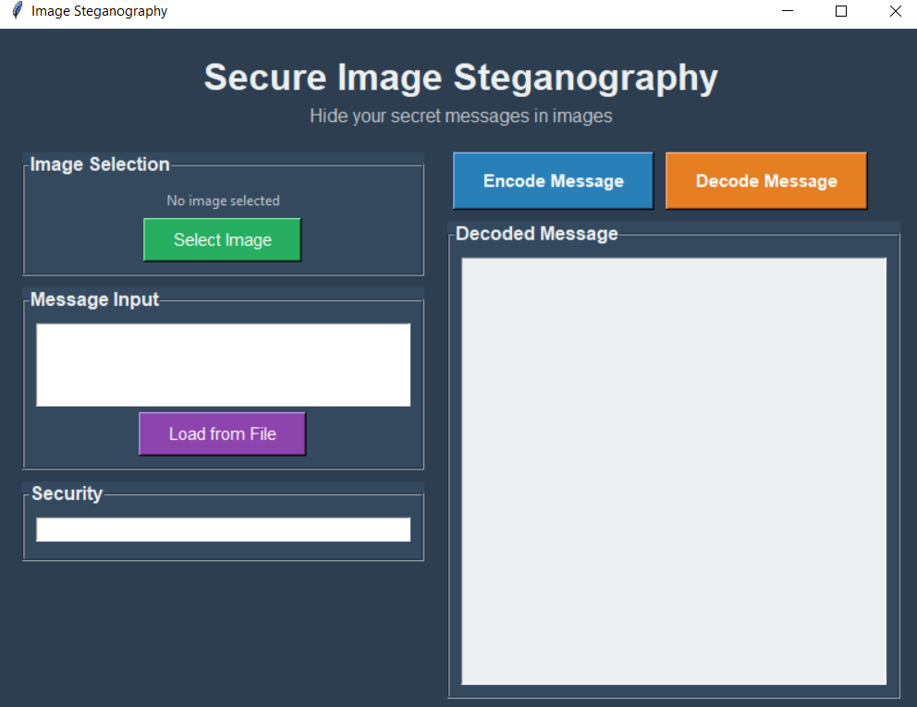
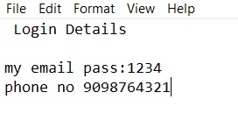
Results

Slide 8
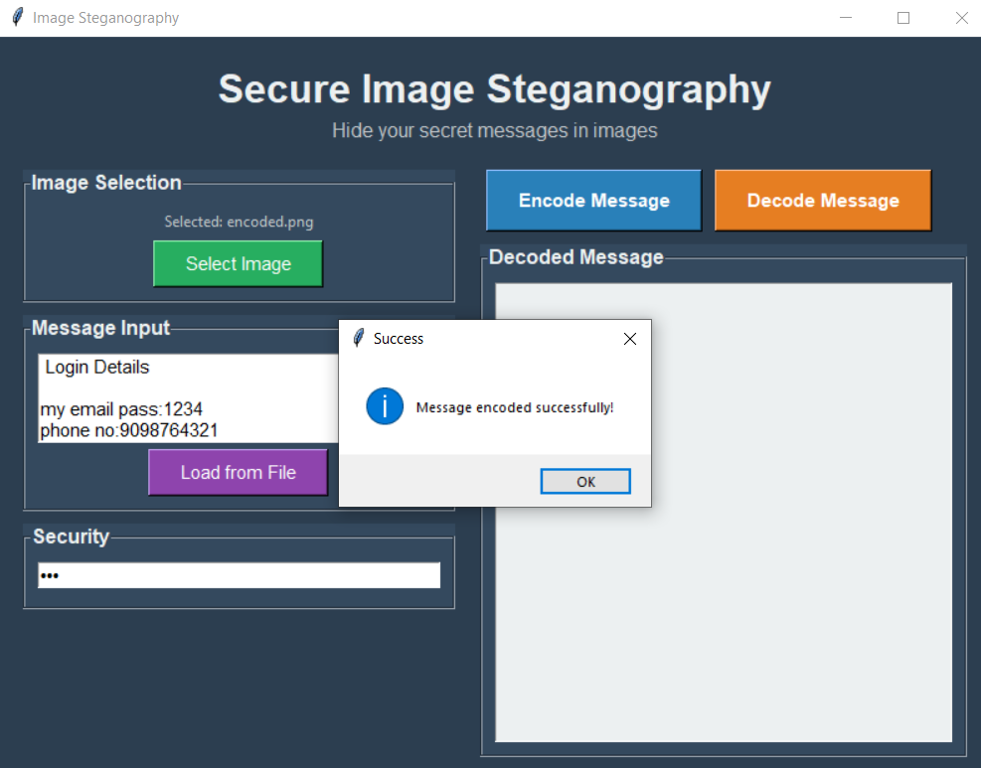
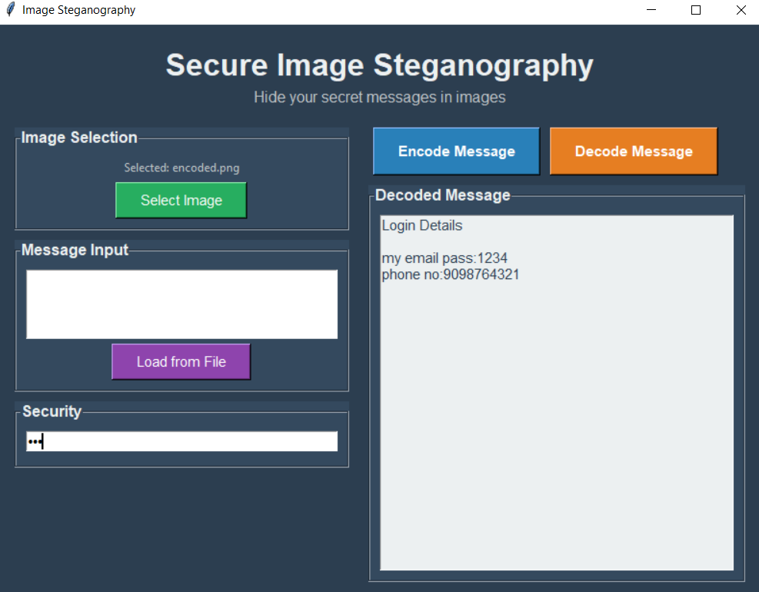
Results

Slide 9
Conclusion
This Image Steganography application effectively addresses the need for covert communication by providing a secure and user-friendly solution for embedding messages within digital images. The project successfully meets its key objectives by:
Security & Privacy – Implements LSB steganography with password protection, ensuring secret messages remain hidden and undetectable to unauthorized users.
Accessibility – Features an intuitive dark-themed GUI, making steganography easily usable for both technical and non-technical individuals.
Reliability – Maintains message integrity with automatic capacity checking and efficient pixel utilization, preventing data loss or corruption.
This project bridges the gap between security and usability, making secure communication accessible to privacy-conscious individuals, educators, and security professionals.

Slide 10
GitHub Link
GitHub Link:- https://github.com/SuyashBharte/aicte_intern_project.git

Slide 11
Future scope
Enhanced Security: Incorporates advanced encryption algorithms (AES/RSA) alongside steganography, with extended support for hiding messages in audio and video files.
Advanced Features: Integrates blockchain for message verification, enables cloud storage for secure image sharing and enhances security with AI-powered steganography detection resistance.
Cross-Platform Development: Supports mobile application development (Android/iOS) and a web-based version with real-time collaboration capabilities.
User-Friendly Experience: Features an intuitive interface with real-time status updates, automated message capacity checks, and seamless file handling for effortless secure communication.

Slide 12
THANK YOU

